Slide 1


Luis Fernando Paolucci
23/03/2022

Slide 2

Outline
Executive Summary
Introduction
Methodology
Results
Conclusion
Appendix

Slide 3
Executive Summary
Summary of methodologies
Data collection API
Data collection with web scraping
Data wrangling
Exploratory data analysis (EDA) with SQL
Exploratory data analysis (EDA) with visualization
Data visualization with Folium
Interactive Dashboard with Plotly Dash
Machine learning prediction
Summary of all results
Predictive models can distinguish between the different classes. The major problem is false positives.

Slide 4
Introduction
SpaceX advertises Falcon 9 rocket launches with a cost of 62 million dollars; other providers cost upward of 165 million dollars each. Much of the savings is because SpaceX can reuse the first stage. Therefore, if we can determine if the first stage will land, we can determine the cost of a launch. This information can be used if an alternate company wants to bid against SpaceX for a rocket launch.
We want to predict if the Falcon 9 first stage will land successfully.

Slide 5

Section 1

Slide 6
Methodology
Executive Summary
Data collection methodology:
SpaceX API and Wikipedia site data was extracted using scrapping framework of BeautifulSoup.
Perform data wrangling
One-hot encoding was applied to transform categorical variables to numerical values
Perform exploratory data analysis (EDA) using visualization and SQL
Perform interactive visual analytics using Folium and Plotly Dash
Perform predictive analysis using classification models
We used Scikit-learn pipelines with various classification models. Optimal hyperparameters are detected by grid searches.

Slide 7
Data Collection
Wikipedia site data was extracted using scrapping framework of BeautifulSoup.
Data collection was done using get request to the SpaceX API.
The objective was to extract the launch records as HTML table, parse the table and convert it to pandas DataFrame for further analysis.

Slide 8
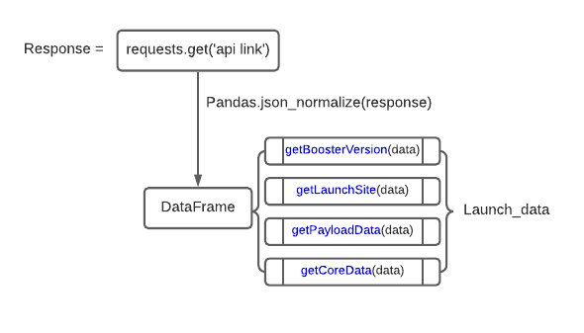
Data Collection – SpaceX API
We requested and parsed the SpaceX launch data using the GET request from the SpaceX API url.
Add the GitHub URL of the completed SpaceX API calls notebook:
https://github.com/luispaolucci/capstone/blob/eace8c907feecb77b4376fbcf44b3d33585439f1/Week%201%20-%20N1%20-%20Data%20Collection%20API.ipynb

Slide 9
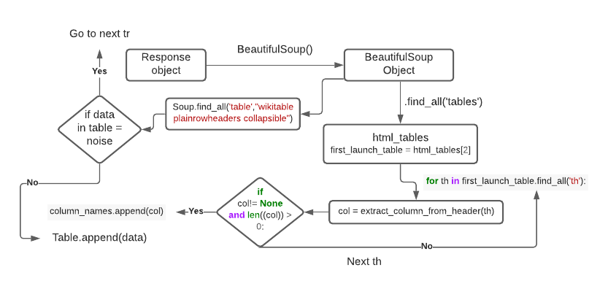
Data Collection - Scraping
Applied web scrapping to webscrap Falcon 9 launch records with BeautifulSoup
Parsed the table and converted it into pandas DataFrame.
Add the GitHub URL of the completed web scraping notebook:
https://github.com/luispaolucci/capstone/blob/eace8c907feecb77b4376fbcf44b3d33585439f1/Week%201%20-%20N2%20-%20Data%20Collection%20with%20Web%20Scraping.ipynb

Slide 10
Data Wrangling
Loaded Falcon 9 data
Transformed to DataFrame using pandas
Missed values in Payload are filled by its average
Created a landing outcome label
Exported to CSV
Add the GitHub URL of your completed data wrangling related notebooks:
https://github.com/luispaolucci/capstone/blob/eace8c907feecb77b4376fbcf44b3d33585439f1/Week%201%20-%20N3%20-%20EDA.ipynb
Transforming to DataFrame using pandas
Cleaning and handling missing values
Using dummies to transform categorical values into numeric
Loading data
Exporting to CSV

Slide 11
EDA with Data Visualization
Summarize what charts were plotted and why you used those charts
Data was explored by visualizing the relationship between flight number and launch Site, payload and launch site, success rate of each orbit type, flight number and orbit type, the launch success yearly trend.
Add the GitHub URL of your completed EDA with data visualization notebook:
https://github.com/luispaolucci/capstone/blob/eace8c907feecb77b4376fbcf44b3d33585439f1/Week%202%20-%20N2%20-%20EDA%20with%20Data%20Visualization.ipynb

Slide 12
EDA with SQL
Loaded the SpaceX dataset into a PostgreSQL database and applied EDA with SQL to get insight from the data. Summary of queries:
The names of unique launch sites in the space mission.
The total payload mass carried by boosters launched by NASA (CRS)
The average payload mass carried by booster version F9 v1.1
The total number of successful and failure mission outcomes
The failed landing outcomes in drone ship, their booster version and launch site names.

Slide 13
EDA with SQL
Add the GitHub URL of your completed EDA with SQL notebook:
https://github.com/luispaolucci/capstone/blob/eace8c907feecb77b4376fbcf44b3d33585439f1/Week%202%20-%20N1%20-%20EDA%20with%20SQL.ipynb

Slide 14
Build an Interactive Map with Folium
Marked all launch sites, and added map objects such as circles, markers, lines to mark the success or failure of launches for each site on the folium map.
Assigned the feature launch outcomes (failure or success) to class 0 and 1
Using the color-labeled marker clusters, identified which launch sites have relatively high success rate.
Calculated the distances between a launch site to its proximities to answer questions:
Are launch sites near railways, highways and coastlines.
Do launch sites keep certain distance away from cities.
Add the GitHub URL of your completed interactive map with Folium map:
https://github.com/luispaolucci/capstone/blob/eace8c907feecb77b4376fbcf44b3d33585439f1/Week%203%20-%20N1%20-%20Interactive%20Visual%20Analytics%20Folium.ipynb

Slide 15
Build a Dashboard with Plotly Dash
Built an interactive dashboard with Plotly dash
Plotted pie charts showing the total launches by a certain sites
Plotted scatter graph showing the relationship with Outcome and Payload Mass (Kg) for the different booster version.
I added those plots and interactions for a more dynamic exploratory analysis and to give the client the ability to explore what is in the data and draw insight
Add the GitHub URL of your completed Plotly Dash lab:
https://github.com/luispaolucci/capstone/blob/eace8c907feecb77b4376fbcf44b3d33585439f1/Week%203%20-%20N2%20-%20Dashboard%20Application%20Plotly%20Dash.ipynb

Slide 16
Predictive Analysis (Classification)
We used Scikit-learn and made pipelines to implement various classification models. Models are validated by cross validation and tested.
We used grid-search to find an optimal hyperparameters of each model and compared the performances.
Add the GitHub URL of your completed predictive analysis lab:
https://github.com/luispaolucci/capstone/blob/eace8c907feecb77b4376fbcf44b3d33585439f1/Week%204%20-%20N1%20-%20Machine%20Learning%20Prediction.ipynb

Slide 17
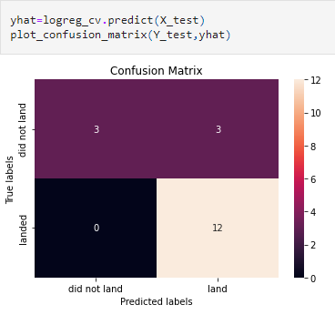
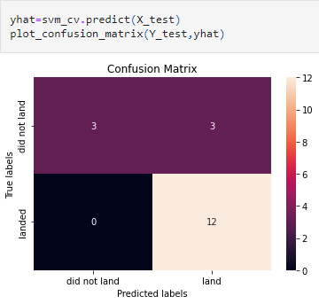
Results
Logistic Regression:
SMV regression:

Slide 18
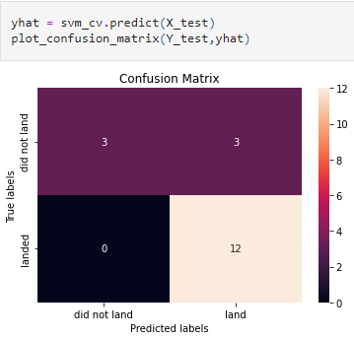
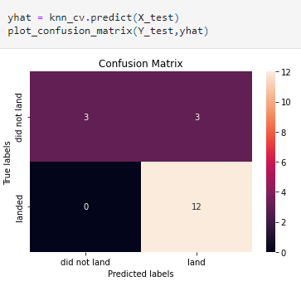
Results
Tree regression:
KNN regression:

Slide 19
Results
The method which performs best is "Decision Tree" with a score of 0.8892857142857145

Slide 20

Section 2

Slide 21
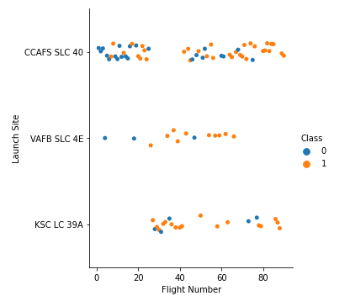
Flight Number vs. Launch Site
From the plot, it can be seen that the larger the flight amount at a launch site, the greater the success rate at a launch site.
Class 0: failure
Class 1: success

Slide 22
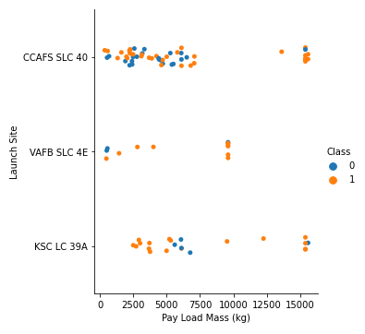
Payload vs. Launch Site
CCAFS SLC 40 had a high chances of success, when the payload mass was lower

Slide 23
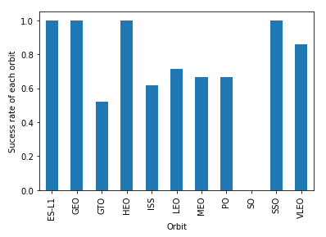
Success Rate vs. Orbit Type
ES-P1, GEO, HEO and SSO orbits have a higher chances of success

Slide 24
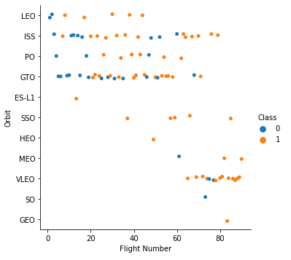
Flight Number vs. Orbit Type
Success appears related to the number of flights; on the other hand, there seems to be no relationship between flight number when in GTO orbit
Class 0: failure
Class 1: success

Slide 25
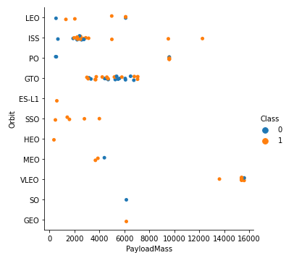
Payload vs. Orbit Type
LEO, GTO, ES-L1, SSO, HEO, MEO, SO, GEO are used for light payload.
VLEO is only for heavy payload.
ISS are used for both light and heavy ones.
Class 0: failure
Class 1: success

Slide 26
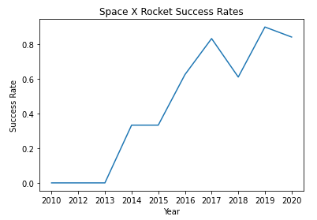
Launch Success Yearly Trend
Sucess rate since 2013 kept increasing till 2019. It shows how much progress had space x done in recent times

Slide 27
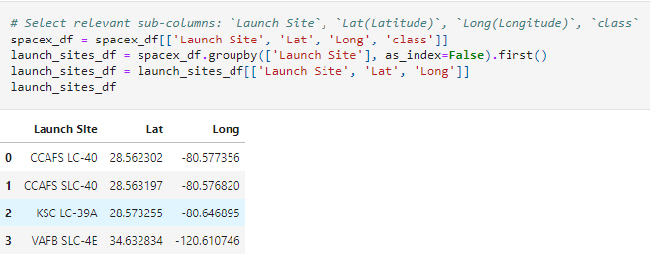
All Launch Site Names
There are four launch sites. Their latitudes and longitudes are listed below:

Slide 28
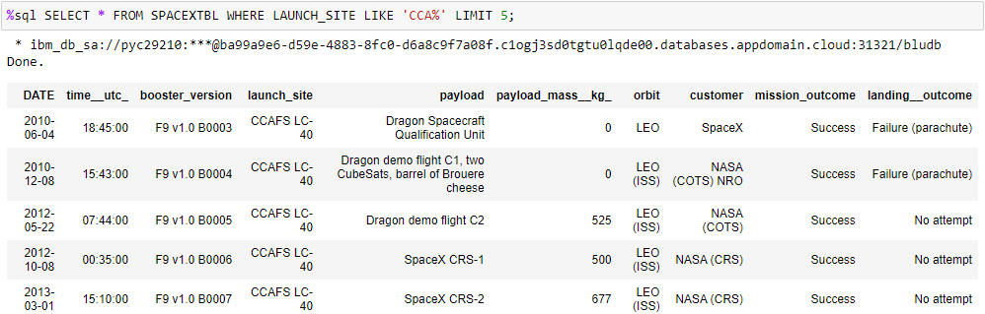
Launch Site Names Begin with 'CCA'
The term LIKE ‘CCA%’ was used to identify records that start with CCA.

Slide 29
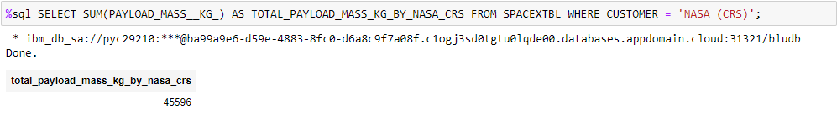
Total Payload Mass
The total payload carried by boosters from NASA is 45596 kg, including heavy payload.

Slide 30
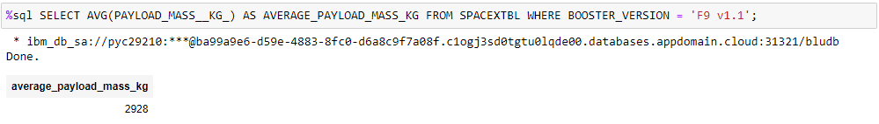
Average Payload Mass by F9 v1.1
The average payload mass carried by booster version F9 v1.1 is 2928 kg.

Slide 31
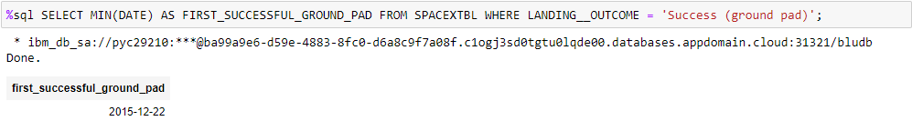
First Successful Ground Landing Date
The dates of the first successful landing outcome on ground pad is 2015-12-22 and MIN(DATE) was used to filter out the first successful landing

Slide 32
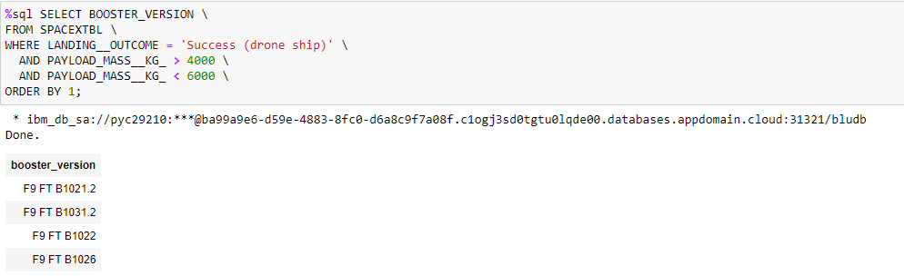
Successful Drone Ship Landing with Payload between 4000 and 6000
WHERE clause was used to filter for boosters which have successfully landed on drone ship and applied the AND condition to determine successful landing with payload mass greater than 4000 but less than 6000

Slide 33
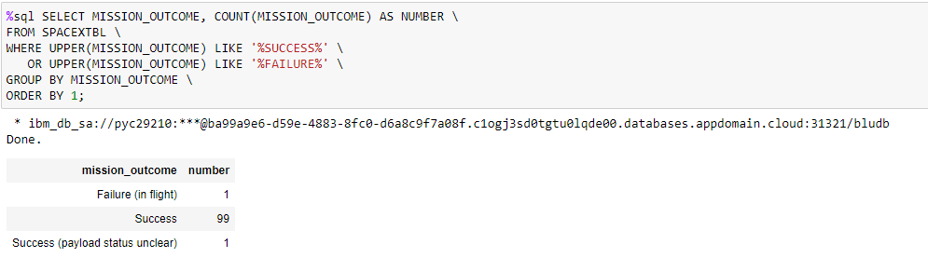
Total Number of Successful and Failure Mission Outcomes
Wildcard like ‘%’ to filter for WHERE Mission_Outcome was a success or a failure.

Slide 34
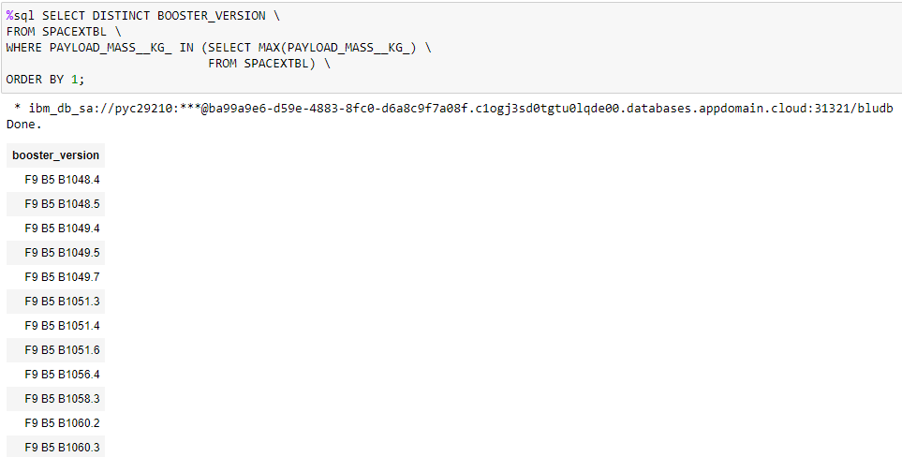
Boosters Carried Maximum Payload
A subquery was used to find the names of boosters that carried the maximum payload

Slide 35
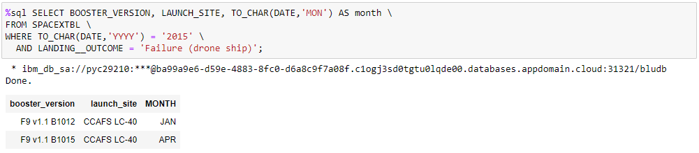
2015 Launch Records
List the failed landing_outcomes in drone ship, their booster versions, and launch site names for in year 2015

Slide 36
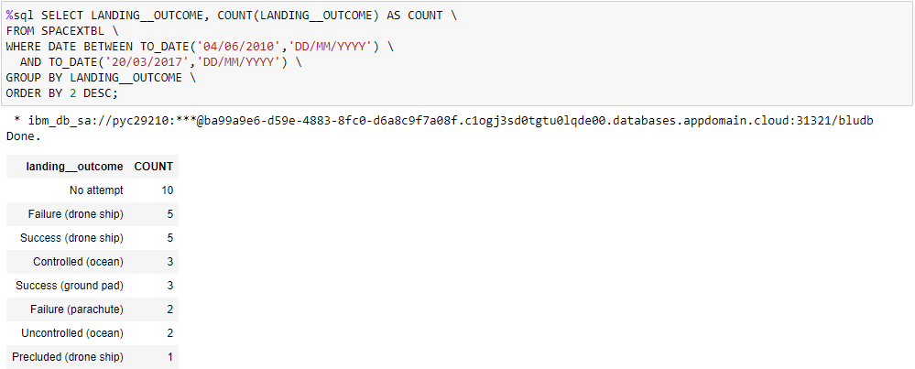
Rank Landing Outcomes Between 2010-06-04 and 2017-03-20
Used COUNT of landing outcomes from the data and the WHERE query to filter for landing outcomes BETWEEN 2010-06-04 to 2017-03-20.
Applied the GROUP BY query to group the landing outcomes and the ORDER BY to order the grouped landing outcome in descending order.

Slide 37

Section 3

Slide 38
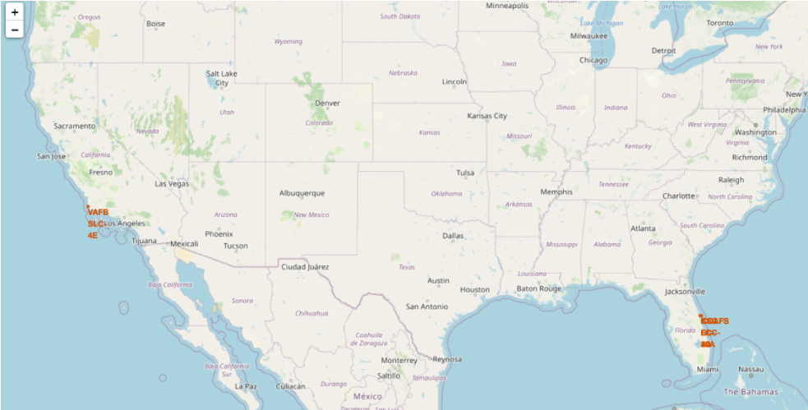
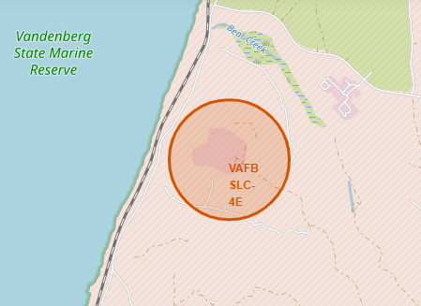
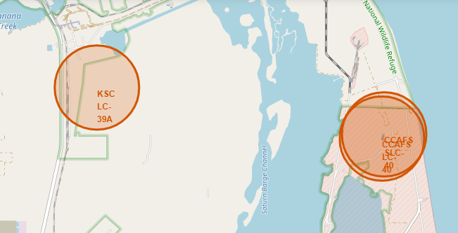
Launch sites of SpaceX space rockets

Slide 39
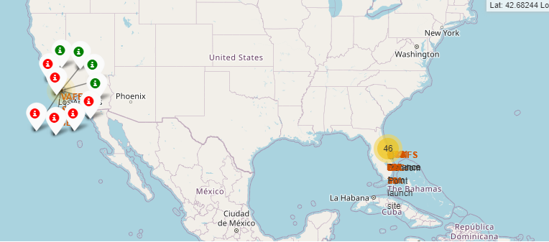
Clusters of launch sites and success rate – part 1 of 3
More launches are conduced in Florida than California.
KSC-LC 39A has the best success rate.

Slide 40
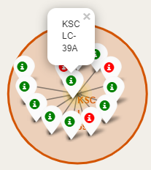
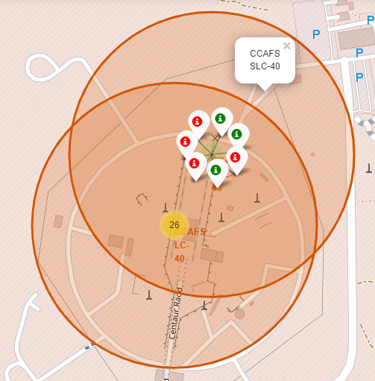
Clusters of launch sites and success rate – part 2 of 3

Slide 41
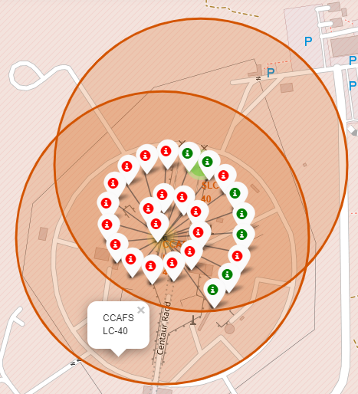
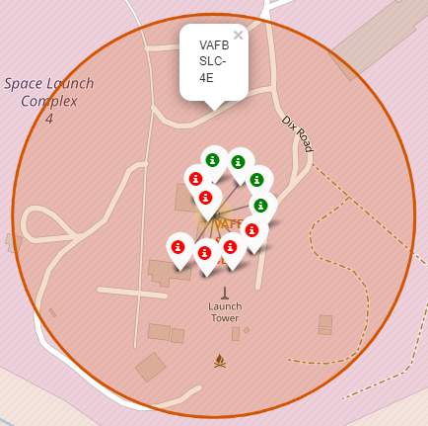
Clusters of launch sites and success rate – part 3 of 3

Slide 42
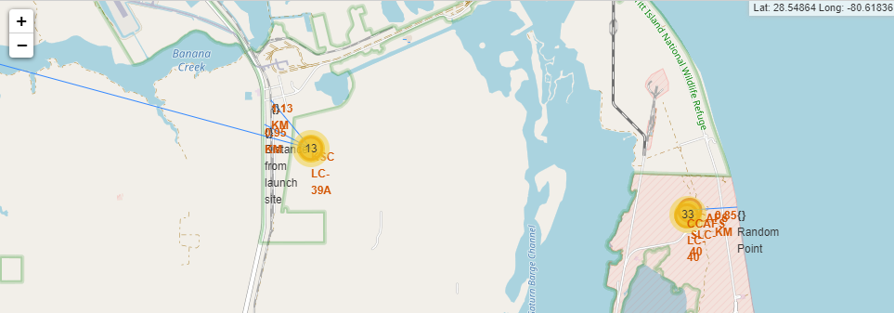
Proximities of a launch site

Slide 43

Section 4

Slide 44
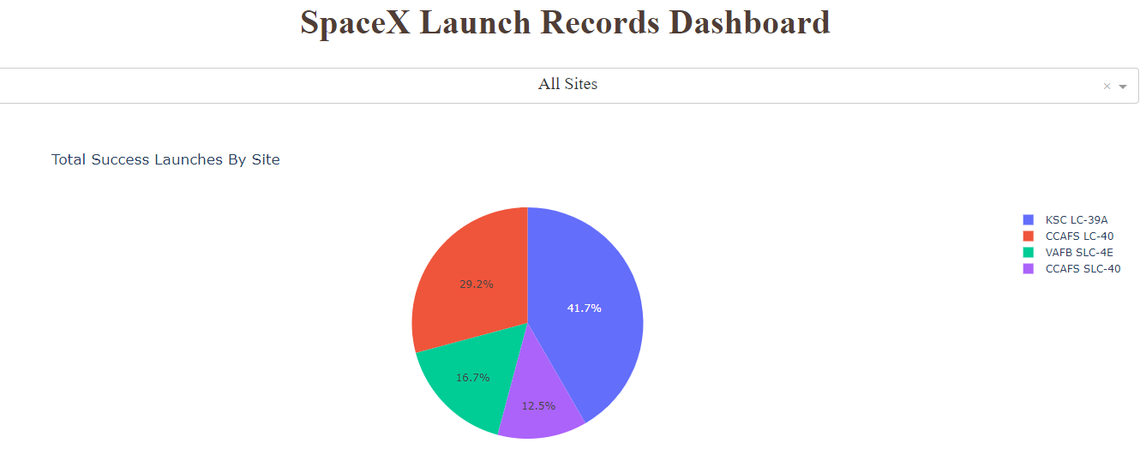
Total success launches by site
KSC LC-39A has the most successful launches and CCAFS SLC-40 has the least one.

Slide 45
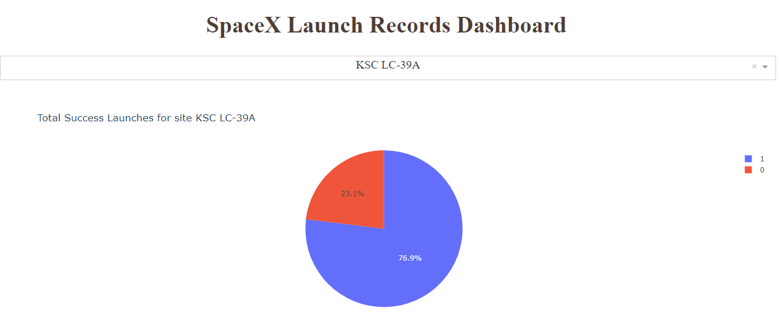
Most successful launch site (KSC LC-39A)
Replace <Dashboard screenshot 2> title with an appropriate title
Success rate in KSC LC-39A: 0=failure (23,1%), 1=success (76,9%)

Slide 46
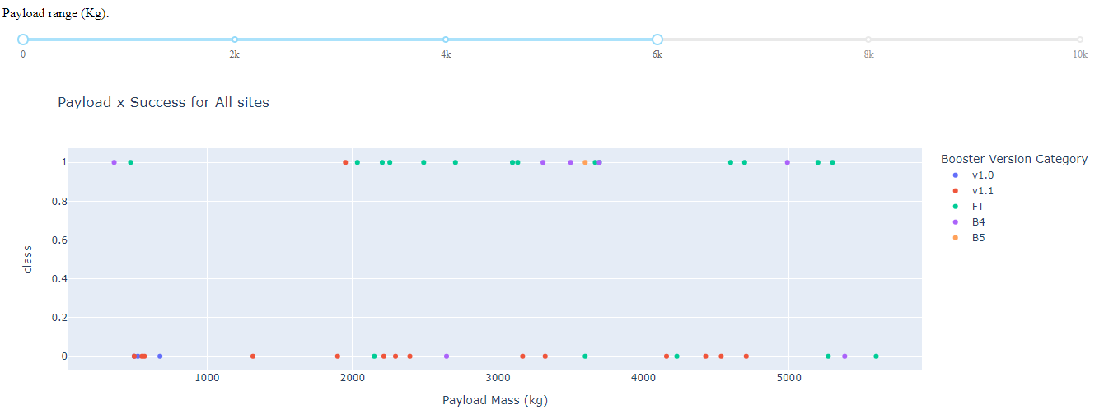
Payload vs Launch Outcome (0 – 6000 kg)

Slide 47
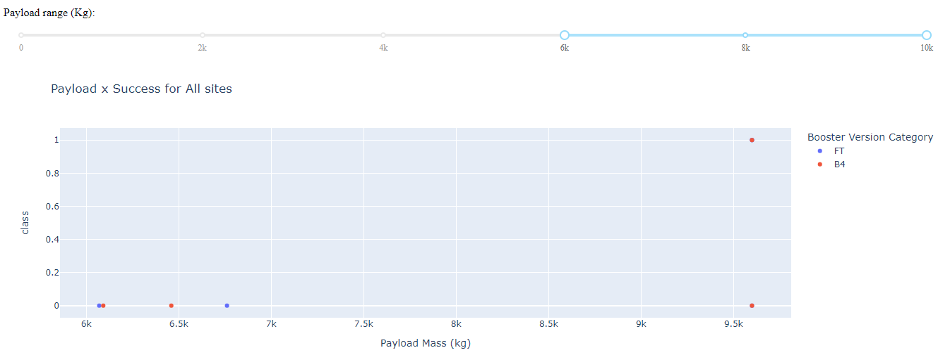
Payload vs Launch Outcome (6000 – 10000 kg)

Slide 48

Section 5

Slide 49
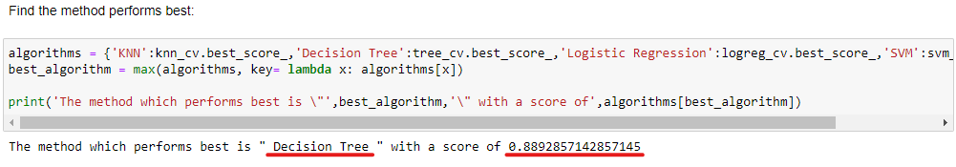
Classification Accuracy
Visualizing model accuracy for all built classification models, in a bar chart
From chart it is clear Decision Tree has a higher performance accuracy as compared with other approaches

Slide 50
Confusion Matrix
Logistic Regression:
SMV regression:

Slide 51
Confusion Matrix
Tree regression:
KNN regression:

Slide 52
Confusion Matrix
All the models that are optimized in hyperparameters give the same confusion matrix.
They are good at classifying the landed targets, while suffering from the false positives.

Slide 53
Conclusions
The launch site KSC LC-39A has the most successful launches and the largest success rate.
KSC LC-39A started launching later than other sites, which explains the higher success rate.
The launches to orbits, GTO and ISS, are more difficult than other orbits.
Predictive model needs improvement on false positives.
Decision Tree has a higher performance accuracy as compared with other approaches

Slide 54


